Slide 1
MINI PROJECT
Team Members
Guide
Akash L
Arjun G
Manimaran V
Saran D
Sethu Raman K
Mrs. Malathy
MCA Department

Slide 2

Object Detection using Tensorflow.js

Slide 3
Abstract
There is an ever-increasing amount of image data in the world, and the rate of growth itself is increasing. Info trends estimates that in 2016 still cameras and mobile devices captured more than 1.1 trillion images. According to the same estimate, in 2020 the figure will increase to 1.4 trillion. Many of these images are stored in cloud services or published on the Internet. In 2014, over 1.8 billion images were uploaded daily to the most popular platforms, such as Instagram and Facebook.
Going beyond consumer devices, there are cameras all over the world that capture images for automation purposes. Cars monitor the road, and traffic cameras monitor the same cars. Robots need to understand a visual scene in order to smartly build devices and sort waste. Imaging devices are used by engineers, doctors and space explorers alike.
Objects contained in image files can be located and identified automatically. This is called object detection and is one of the basic problems of computer vision. As we will demonstrate, convolutional neural networks are currently the state-of-the-art solution for object detection. The main task of this thesis is to review and test convolutional object detection methods.

Slide 4
Applications:
Facial Recognition
People Counting
Industrial Quality Check
Self Driving Cars

Slide 5
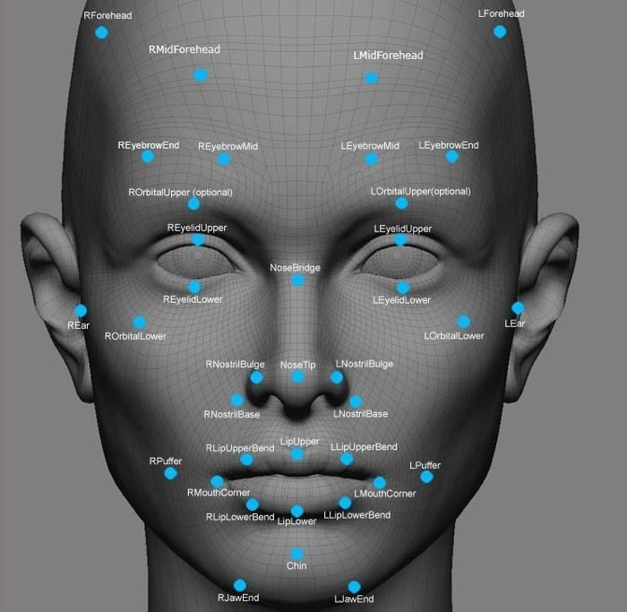
Facial Recognition​
A deep learning facial recognition system called the “DeepFace” has been developed by a group of researchers in Facebook, which identifies human faces in a digital image very effectively.
Google uses its own facial recognition system in Google Photos, which automatically segregates all the photos based on the person in the image.
There are various components involved in Facial Recognition like the eyes, nose, mouth and, eyebrows.

Slide 6
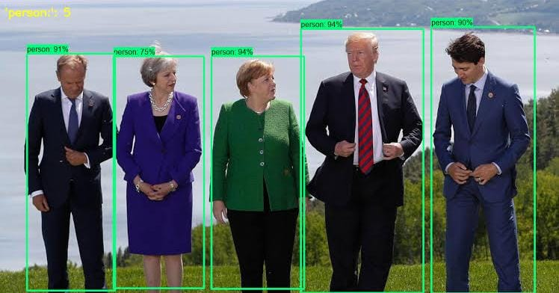
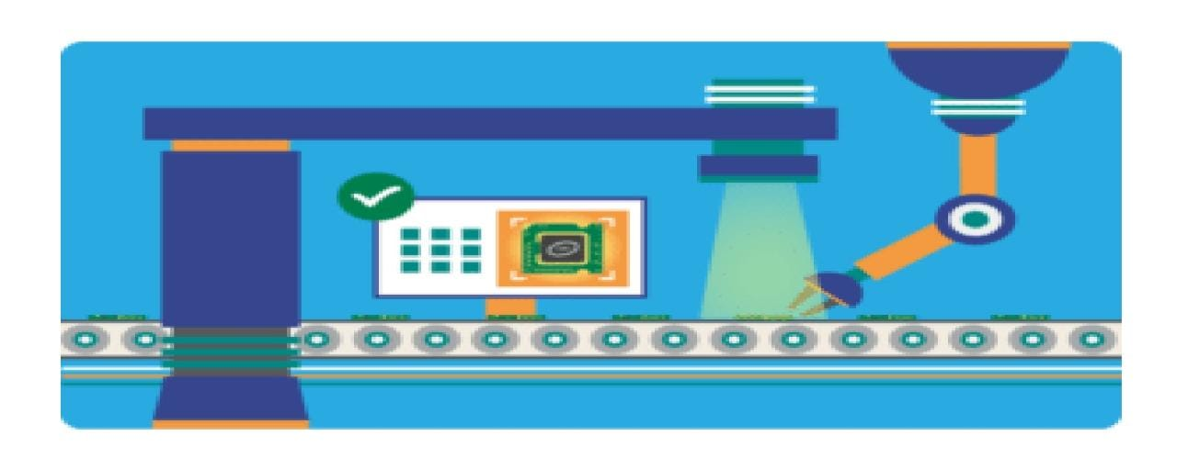
People Counting:
Object detection can be also used for people counting, it is used for analyzing store performance or crowd statistics during festivals. These tend to be more difficult as people move out of the frame quickly.
Industrial Quality Check
1. Object detection is also used in industrial processes to identify products. Finding a specific object through visual inspection is a basic task that is involved in multiple industrial processes like sorting, inventory management, machining, quality management, packaging etc.
2. Inventory management can be very tricky as items are hard to track in real time. Automatic object counting and localization allows improving inventory accuracy.

Slide 7
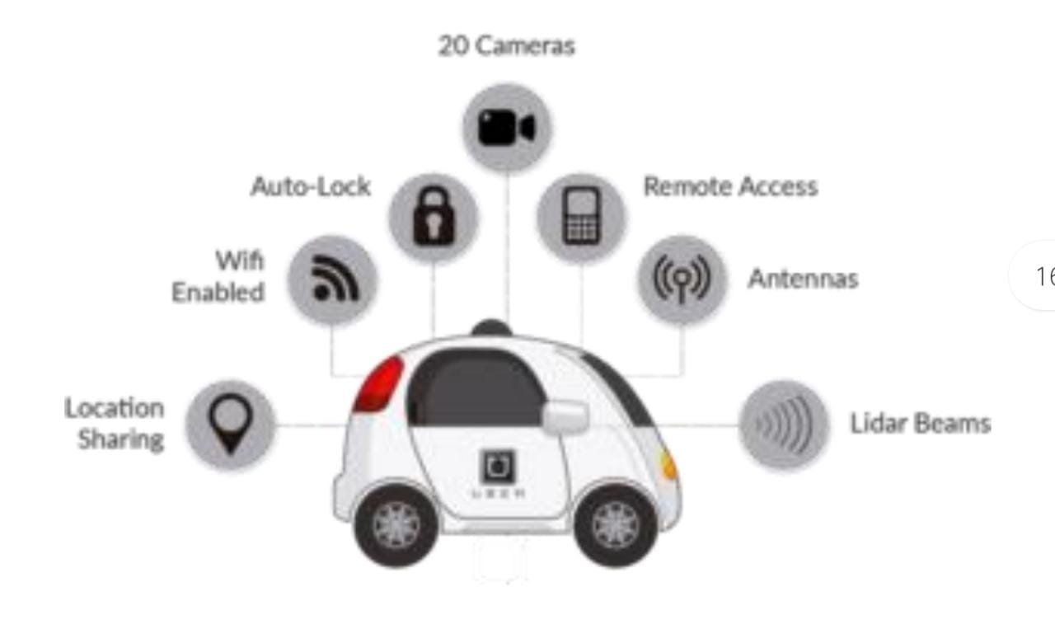
Self Driving Cars :
Self-driving cars are the Future, there’s no doubt in that. But the working behind it is very tricky as it combines a variety of techniques to perceive their surroundings, including radar, laser light, GPS, and computer vision.

Slide 8
Purpose and need:
The purpose of object detection is to detect all instances of objects from a known class, such as people, cars, or faces in an image, etc. In the case of a fixed rigid object, only one example may be needed, but more generally multiple training examples are necessary to capture certain aspects of class variability.
One of the best examples of why you need object detection is the high-level algorithm for autonomous driving:
In order for a car to decide what to do next: accelerate, apply brakes or turn, it needs to know where all the objects are around the car and what those objects are
That requires object detection
You would essentially train the car to detect a known set of objects: cars, pedestrians, traffic lights, road signs, bicycles, motorcycles, etc.

Slide 9

React JS
Introduction

Slide 10
System Requirement :
Hardware Requirement:
* Personal Computer or Laptop
* RAM:- 4GB+
* Processor:- Ryzen 3 3250u,Intel 3 3rd gen
* Storage:- HDD-250GB+ [Recommended-SSD]
* Camera: 5mp+
* Network Connection: Yes
Software Requirement:
* Language: Javascript
* IDE: Visual Studio,Web Storm
* Library: Reactjs, Tensorflow.js

Slide 11





Installing React:
Firstly, To work with react we need to install NodeJS to our system.
Click here to Download for Linux:-
https://nodejs.org/dist/v14.17.6/node-v14.17.6-darwin-x64.tar.gz
Click here to Download for Windows:-
https://nodejs.org/dist/v14.17.6/node-v14.17.6-x64.msi
Click here to Download for Macos:-
https://nodejs.org/dist/v14.17.6/node-v14.17.6.pkg
Check out here for step-by-step installation:-
https://nodejs.org/en/docs/

Slide 12




Slide 13

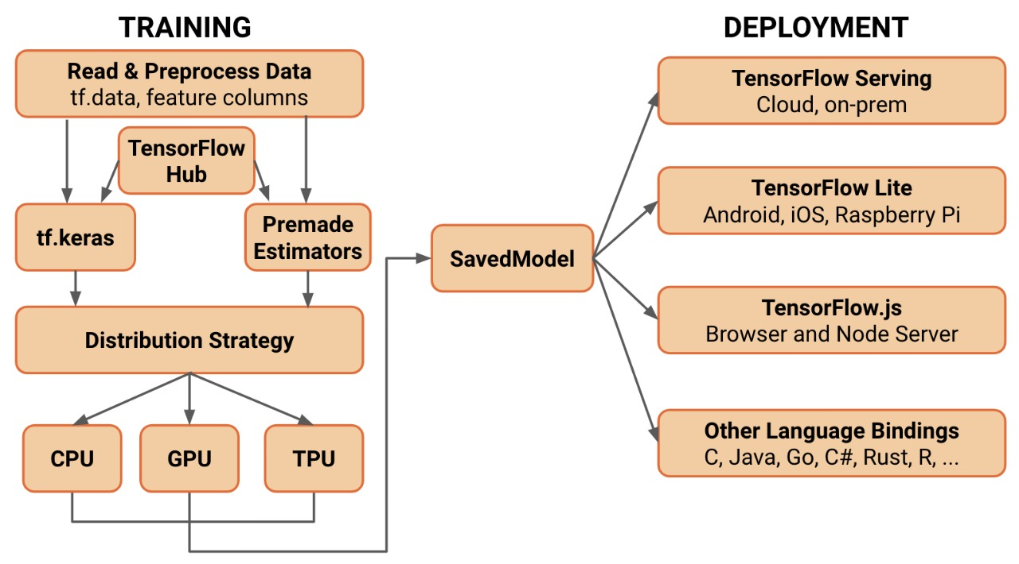
TensorFlow.js is a library for machine learning in JavaScript

Slide 14
TENSORFLOW.JS
Tensorflow.js is an open-source library enabling us to define, train and run machine learning models in the browser, using Javascript.

Slide 15

COCO-SSD MODEL

Slide 16
COCO-SSD Model
Pre-trained object detection model
Identify multiple objects in an image
Tensorflow.js model is very lightweight and optimized for browser execution.

Slide 17
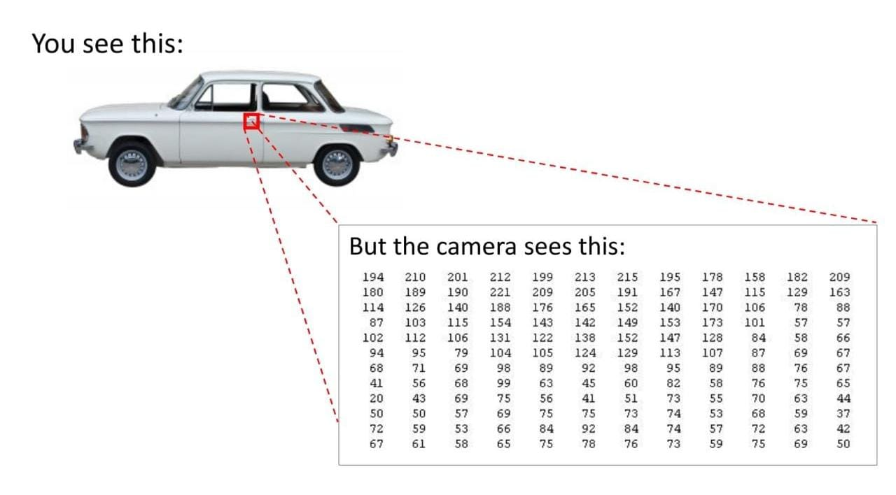
Behind the scenes

Slide 18

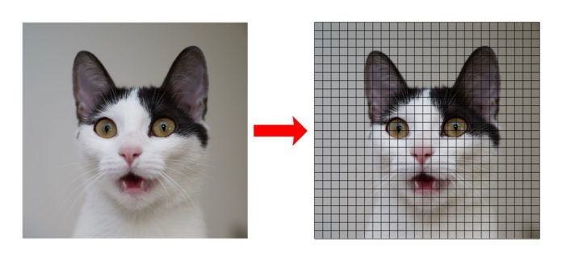
Behind the scenes

Slide 19
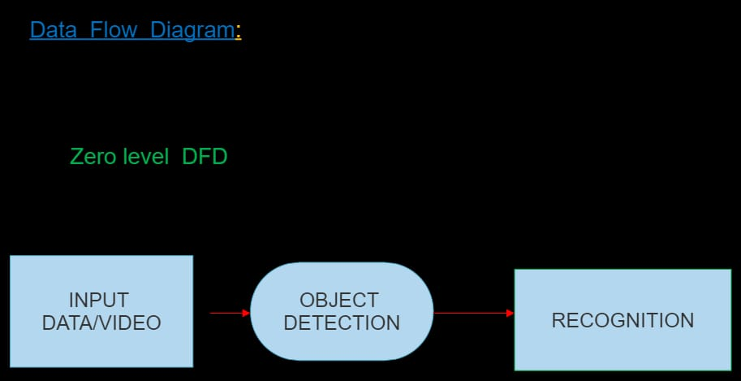

Slide 20
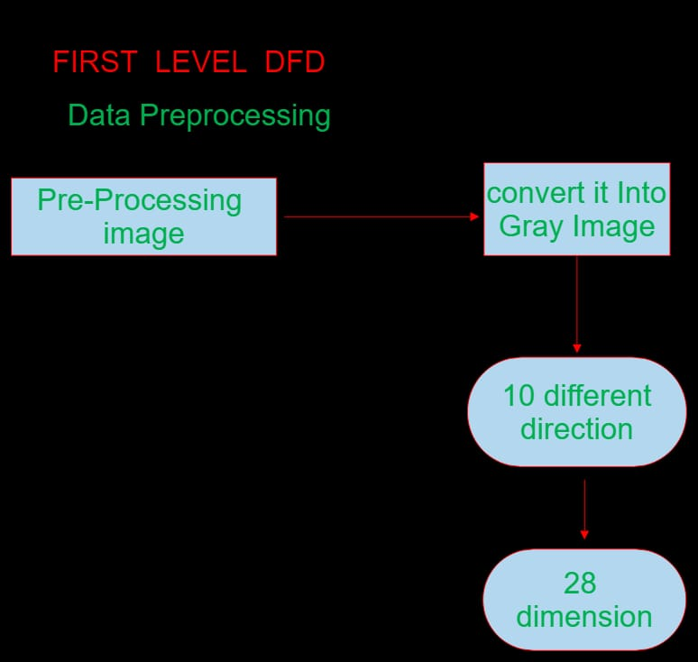

Slide 21
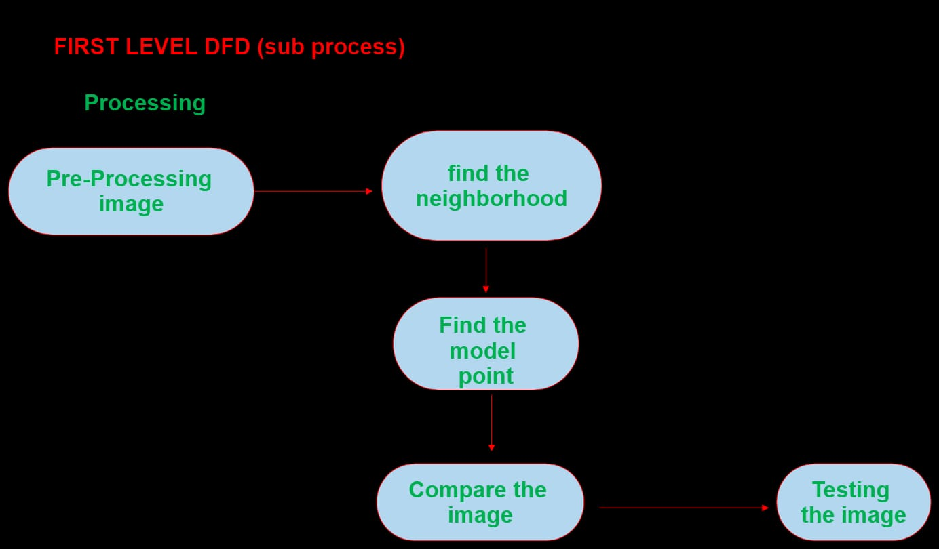

Slide 22
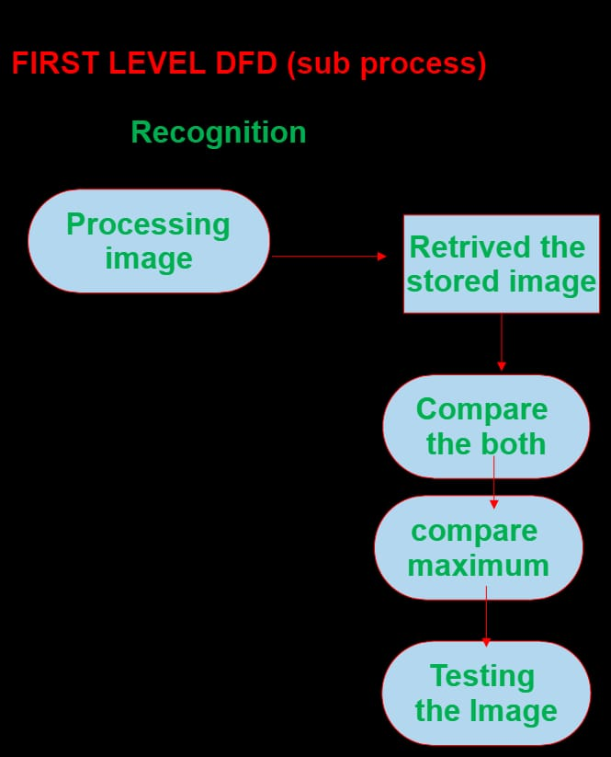

Slide 23
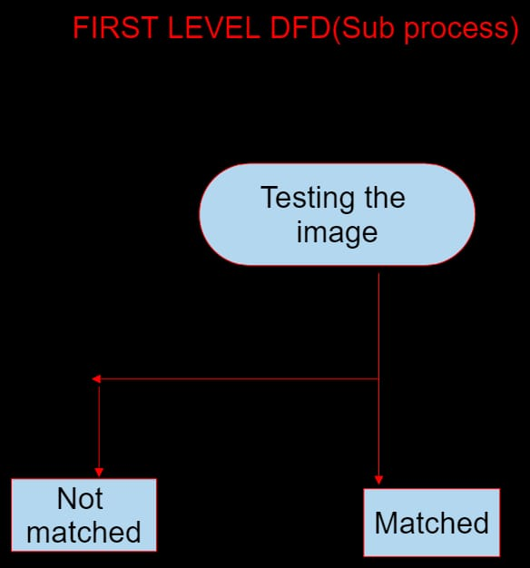

Slide 24
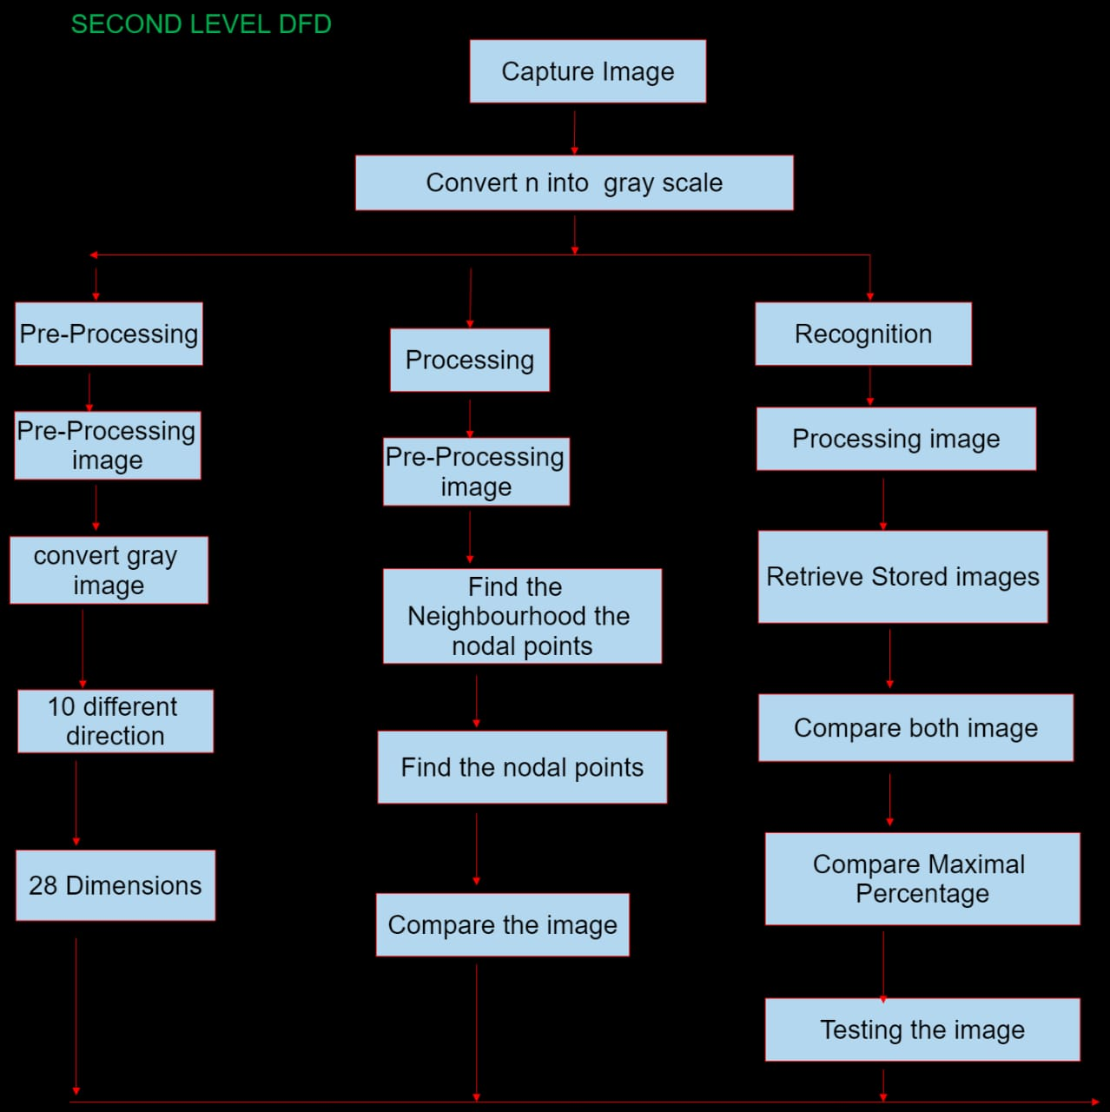

Slide 25
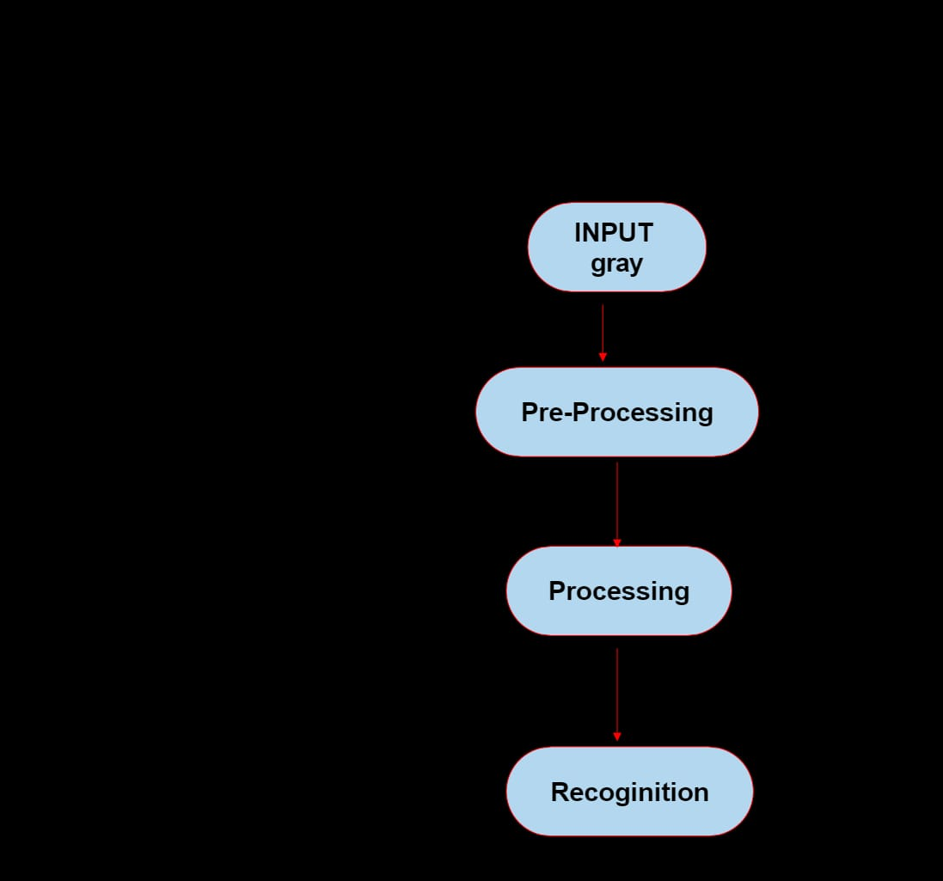
Use case diagram:

Slide 26
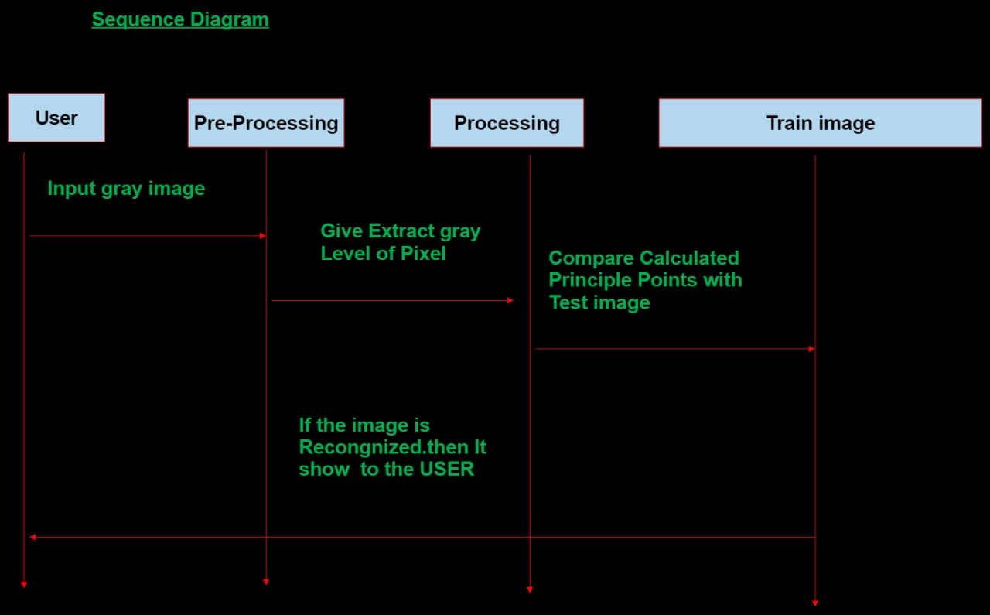

Slide 27

Neural network

Slide 28

Understanding Neural Network:
neural network is a backbone of deep Learning consist of Input layer, hidden layer and output layer.

Slide 29
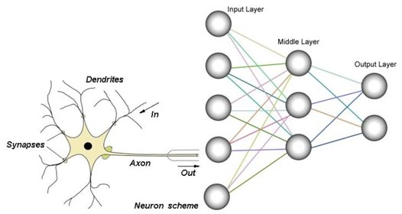
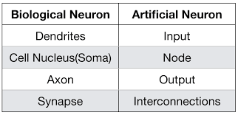

Slide 30
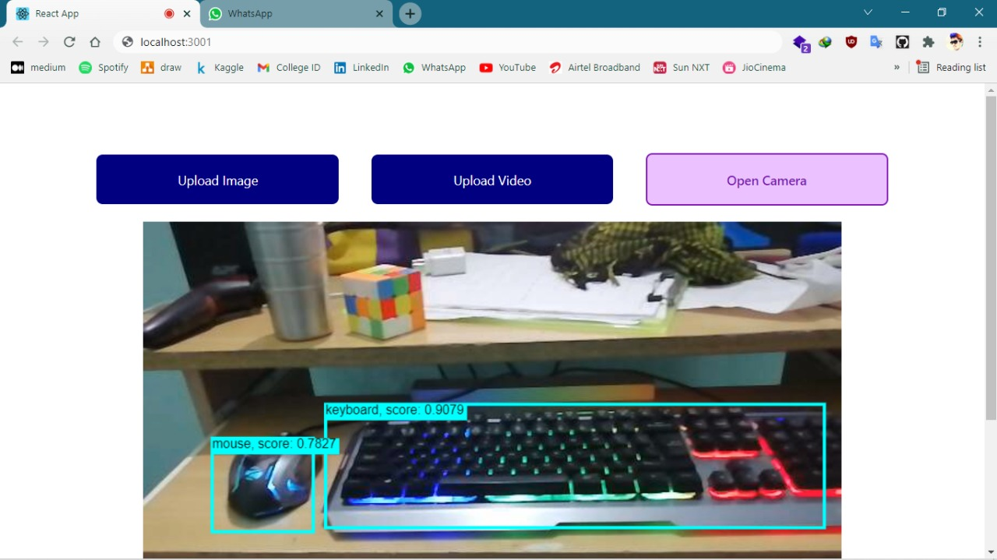
Output of our model:

Slide 31
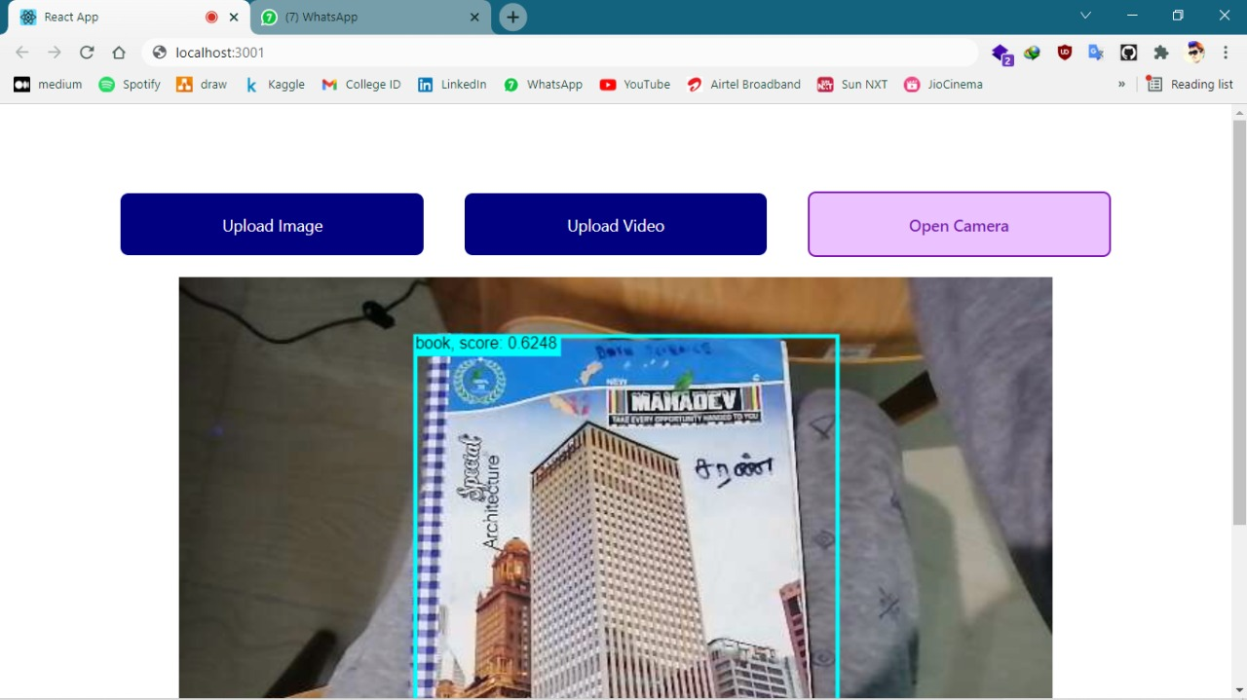
Output of our model:

Slide 32
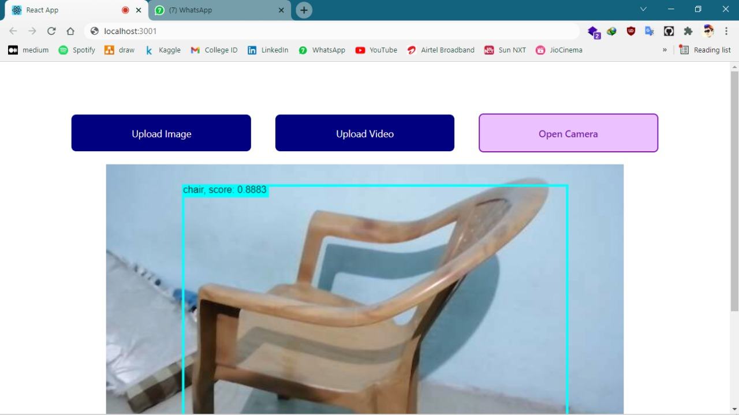
Output of our model:

Slide 33
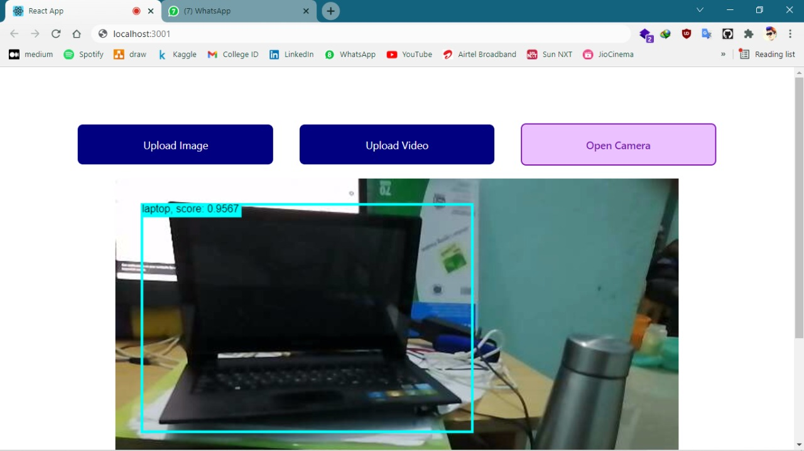
Output of our model:

Slide 34
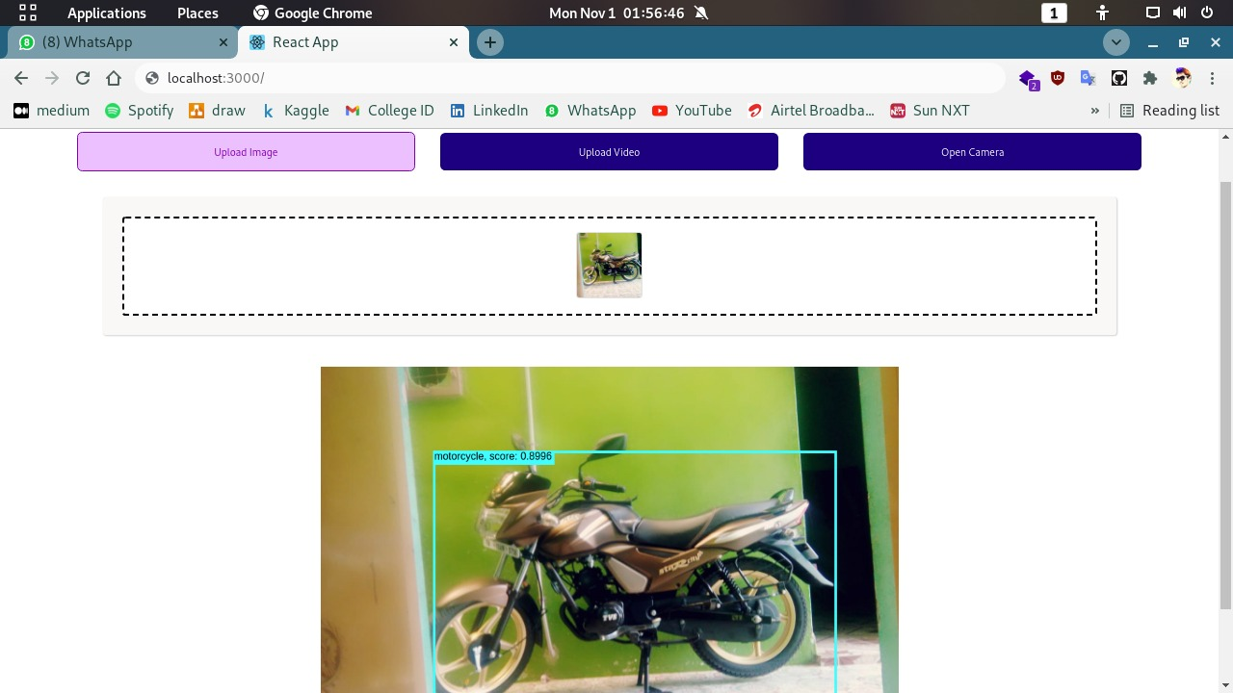
Output of our model:

Slide 35
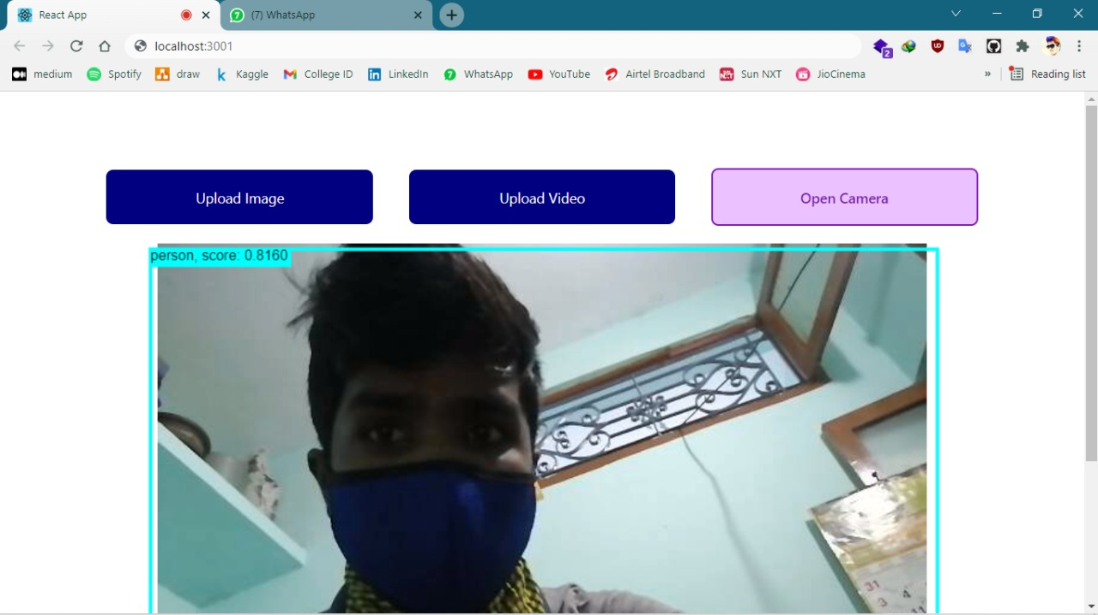
Output of our model:

Slide 36
Reference:
ReactJS:- https://reactjs.org/docs/getting-started.html
TensorflowJS:- https://www.tensorflow.org/js
Javascript:- https://developer.mozilla.org/en-US/docs/Web/JavaScript

Slide 37

Thank you...!!! (any questions)

